Slide 1
SOEN 384
Management, Measurement and Quality Control http://users.encs.concordia.ca/~s384_2/
Demonstrating JDeodorant and ConQAT

Slide 2
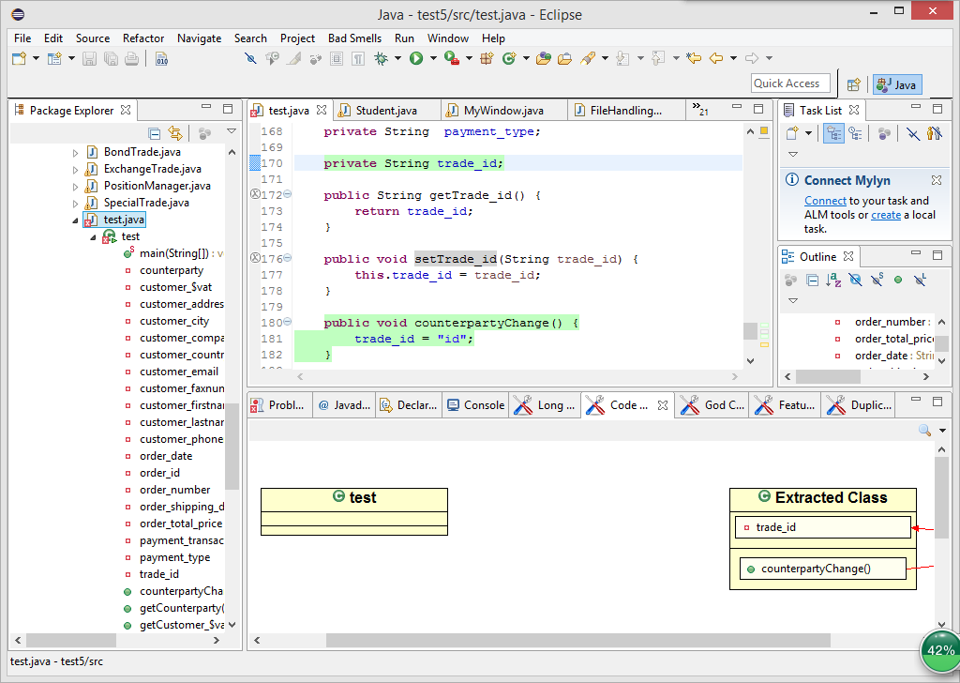
Tools: JDeodorant
JDeodorant is an Eclipse plug-in that identifies design problems in software, known as bad smells, and resolves them by applying appropriate refactorings. It can detect smells: Feature Envy, Long Method, Switch Satements, and Long Class.

Slide 3
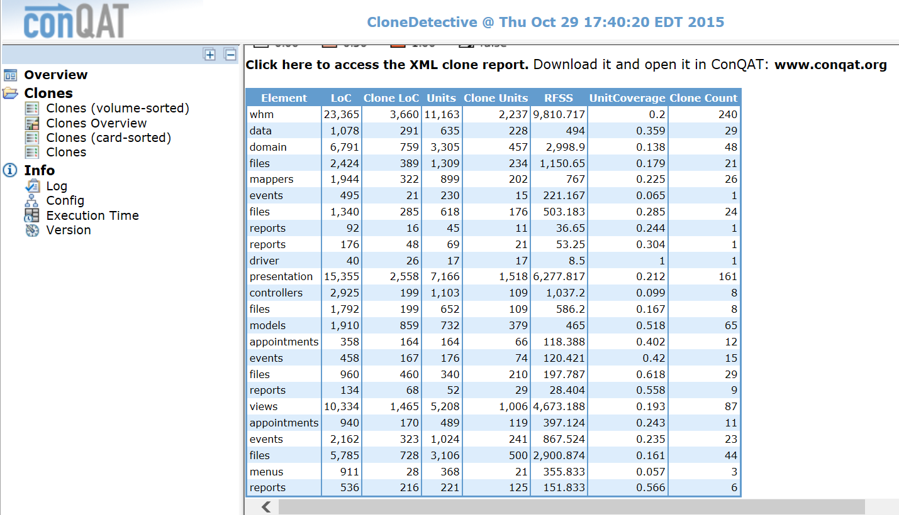
Tools: ConQAT
ConQAT is a toolkit for rapid development and execution of software quality analyses.
Aggregation of quality metrics, Integration of third-party analysis tools (e.g. PMD, Findbugs, FxCop), Clone Detection (detecting duplicated code due to copy&paste programming)

Slide 4
Steps
1. Install conQAT Eclipse and Jdeodorant plug-in
2. Create conQAT project (from example) and import source code
3. Perform Bad Smells analysis
  Launch ConQAT analysis before analyze Duplicated Code

Slide 5
Code Smells
Duplicated Code
Long Method
God Class
Feature Envy

Slide 6
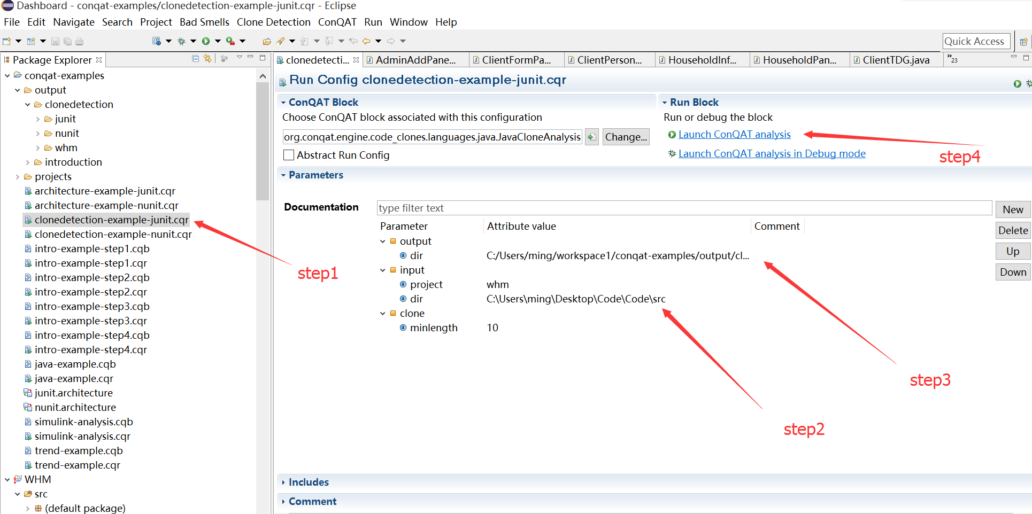
Identify Duplicated Code
Notes:
May not cause a failure of a project

Slide 7
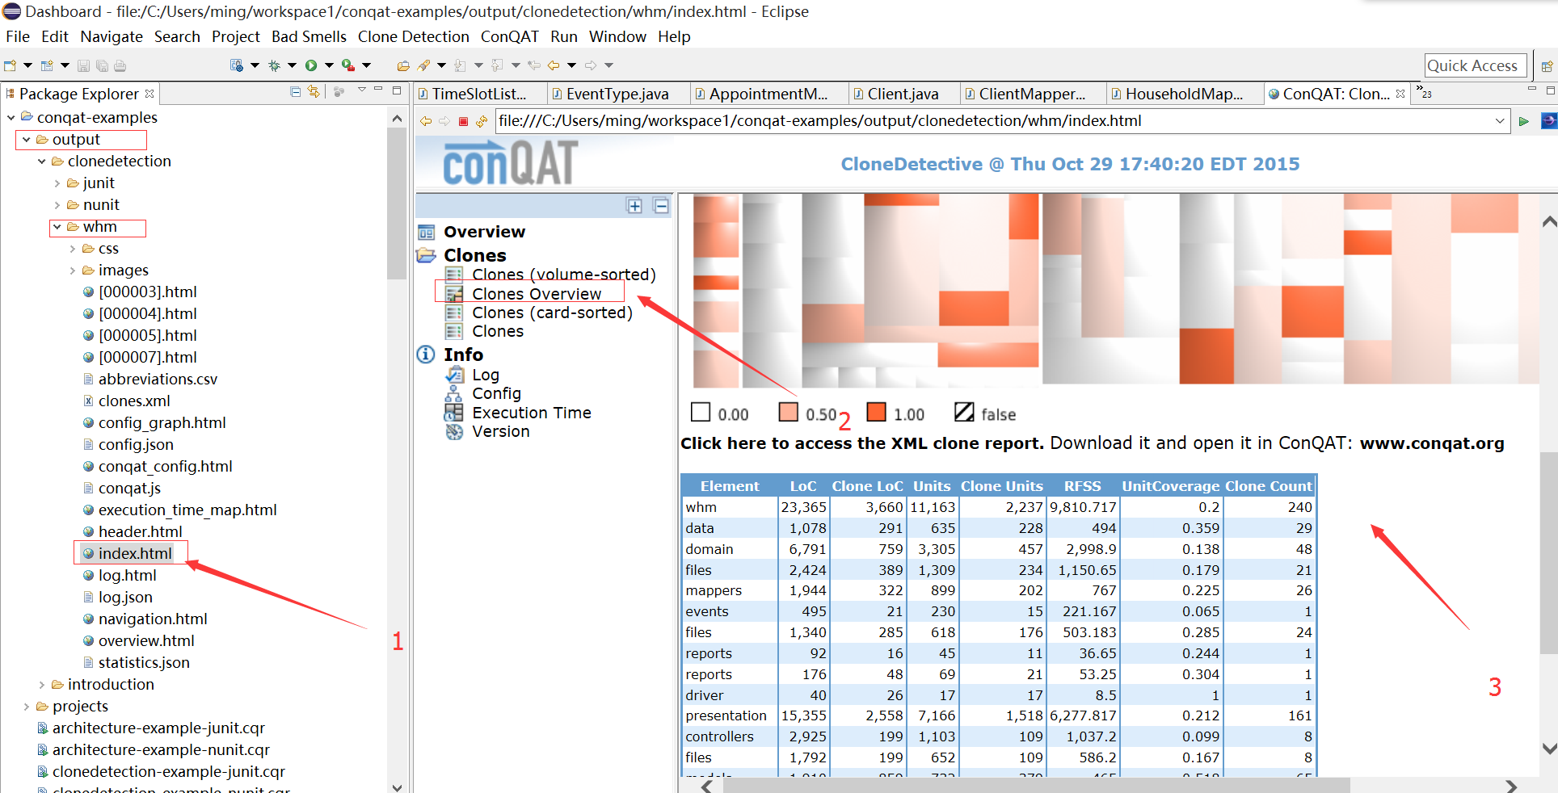
Identify Duplicated Code (Continue)
Notes:
May not cause a failure of a project

Slide 8
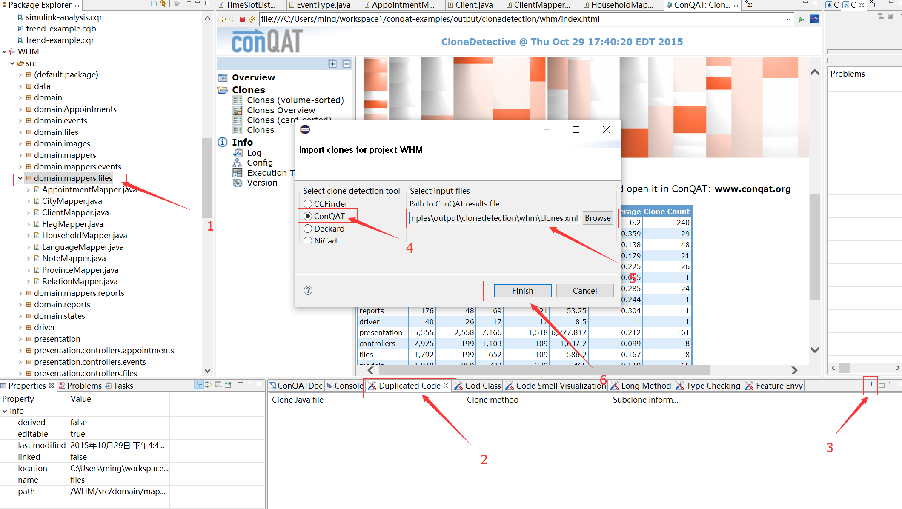
Identify Duplicated Code (Continue)
Notes:
May not cause a failure of a project

Slide 9
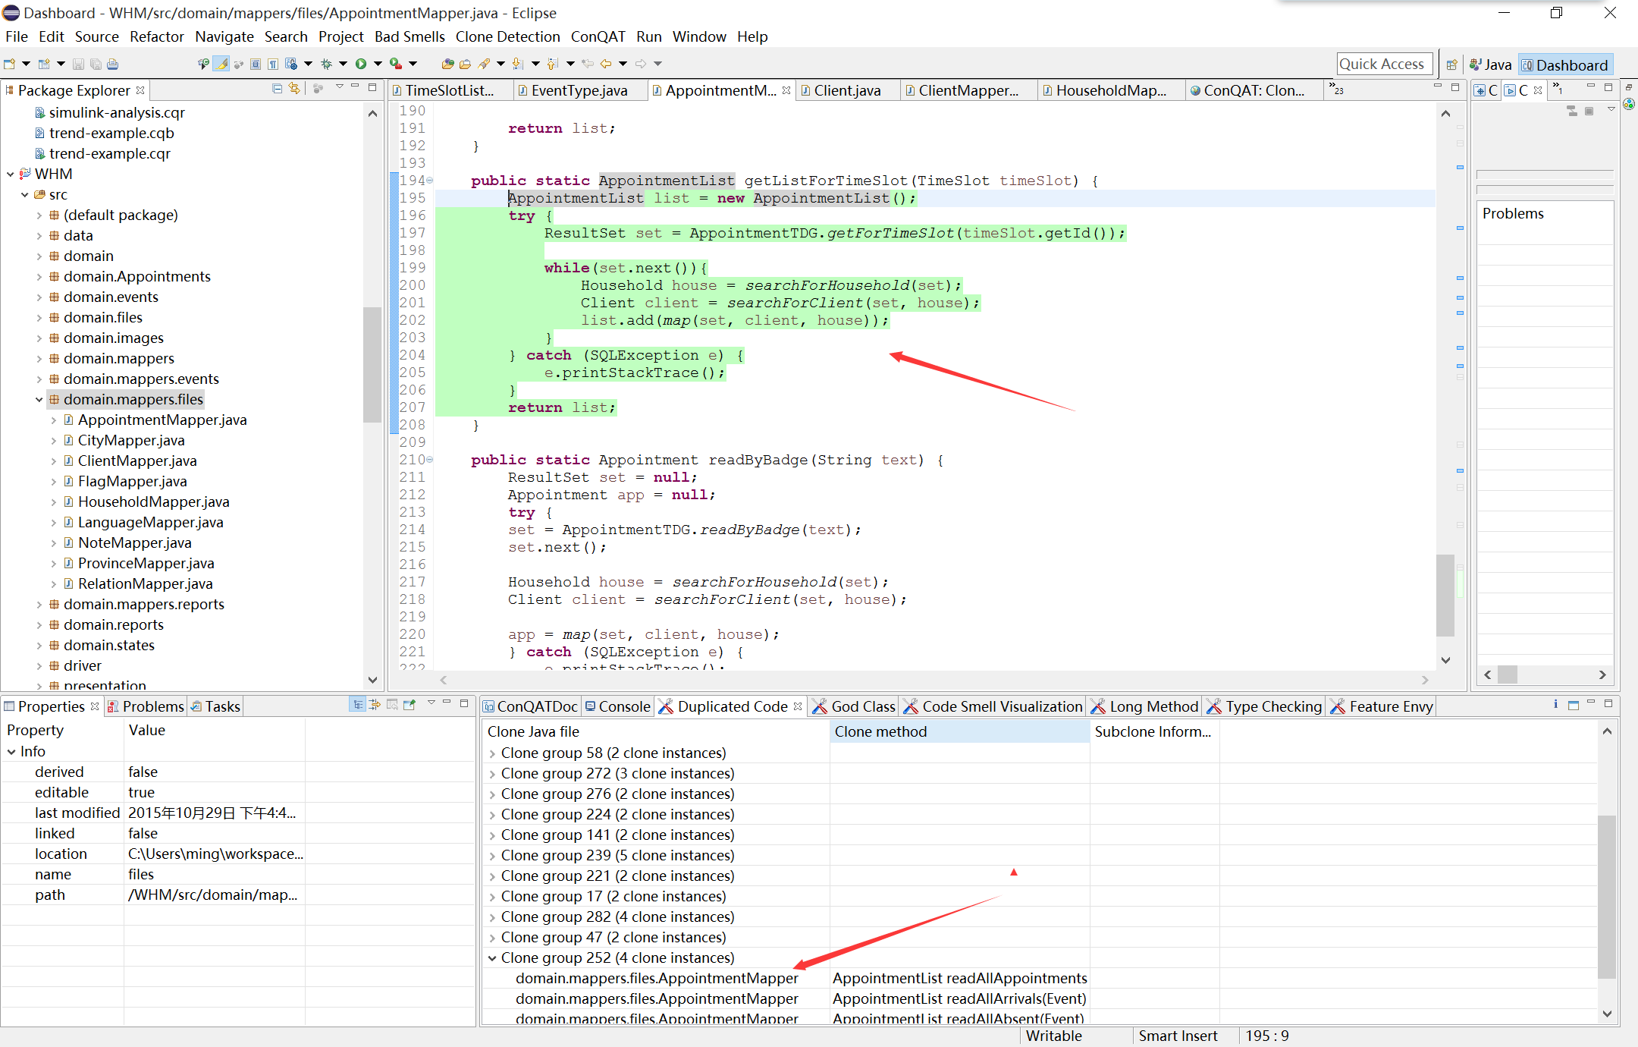
Identify Duplicated Code (Continue)
Notes:
May not cause a failure of a project

Slide 10
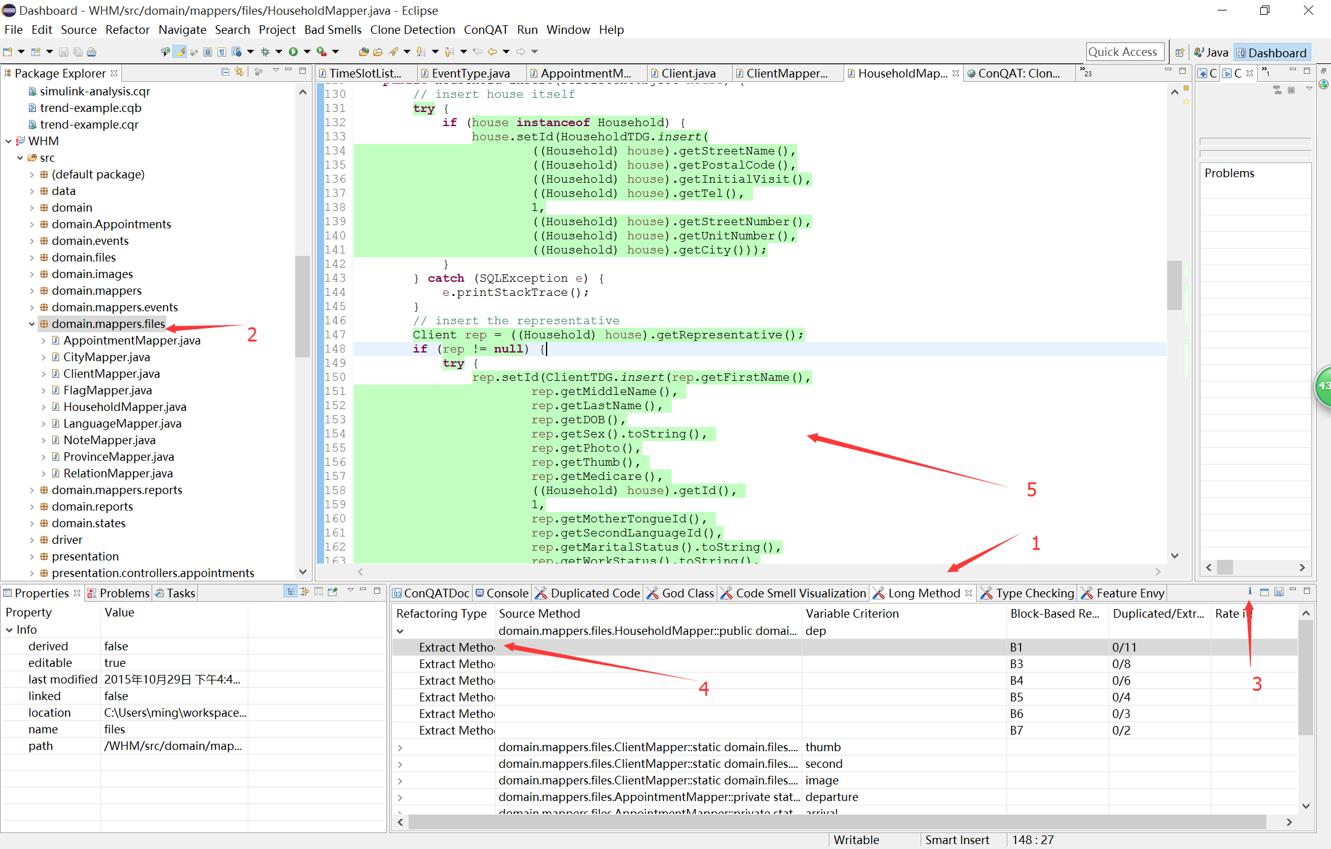
Identify Long Method

Slide 11
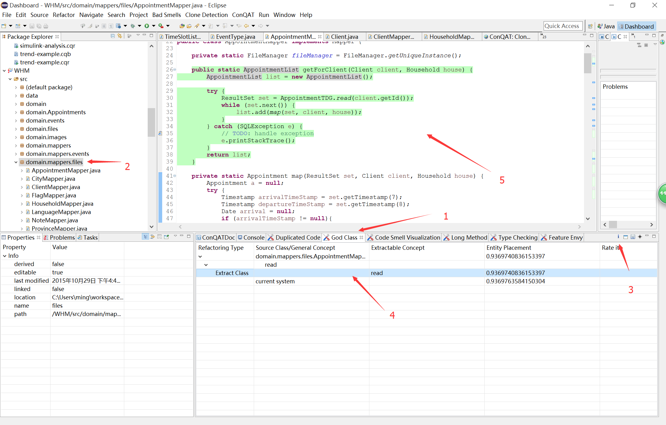
Identify God Class

Slide 12
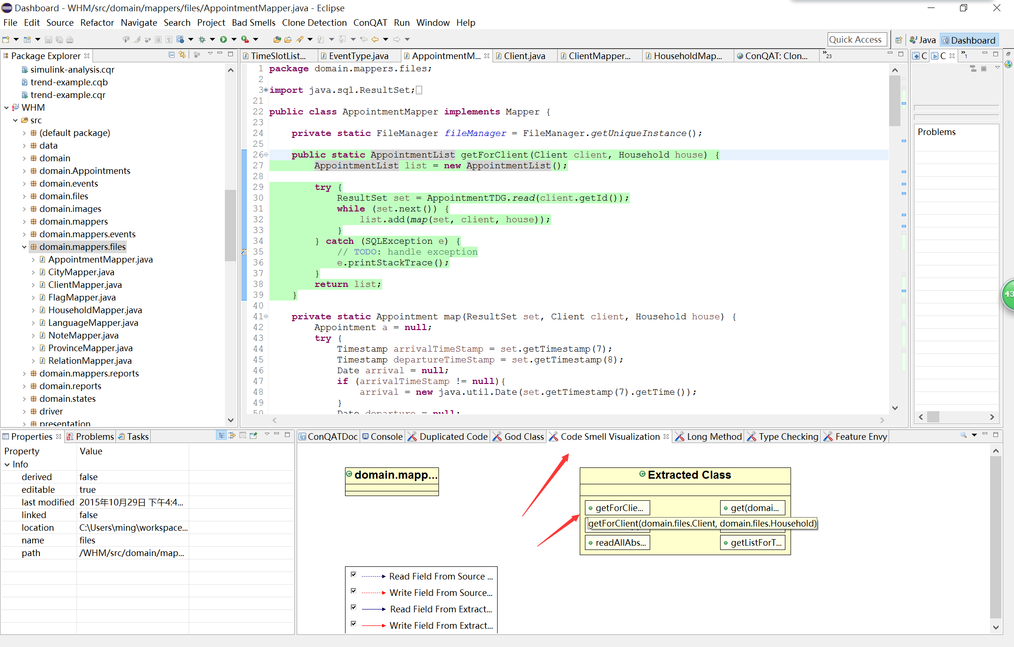
Identify God Class (Continue)

Slide 13
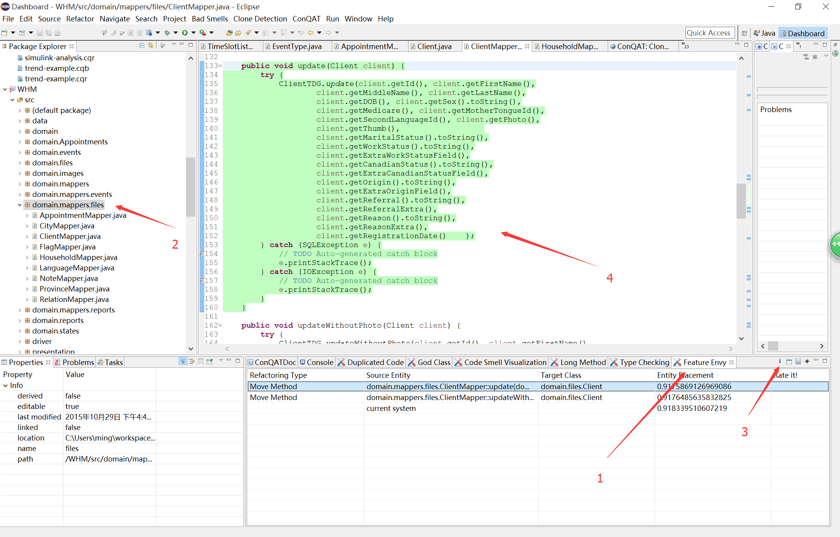
Identify Feature Envy

Slide 14
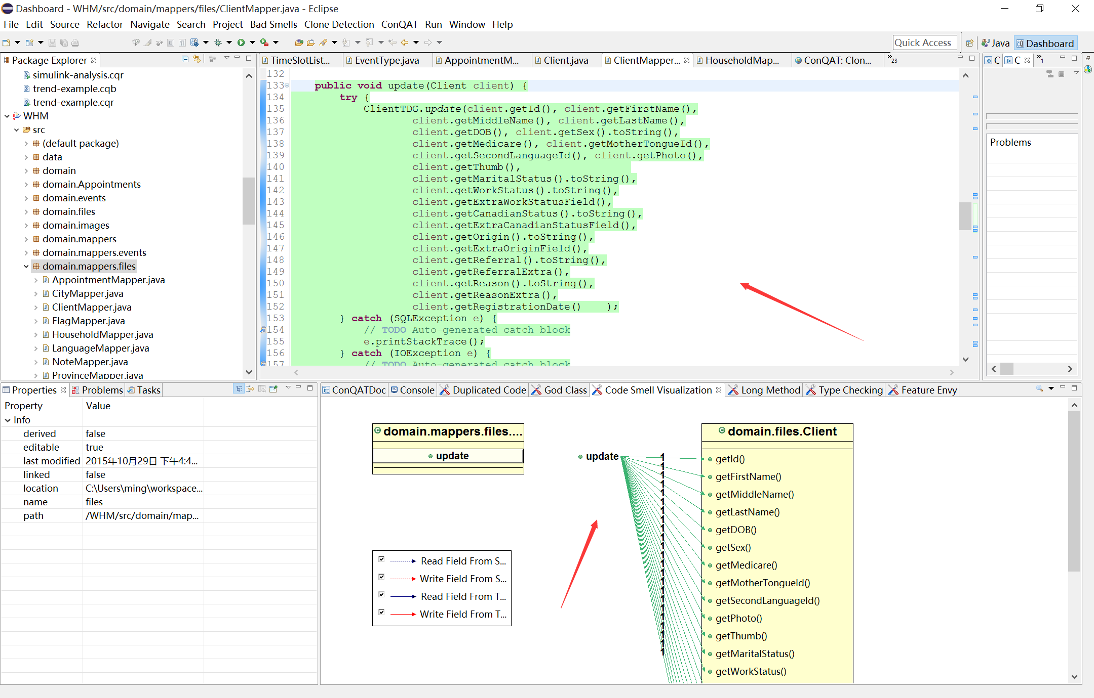
Identify Feature Envy (Continue)

Slide 15
References
https://www.cqse.eu/en/products/conqat/overview/
http://users.encs.concordia.ca/~nikolaos/jdeodorant/

